Slide 1
US Census Demographic Data - 2015

Slide 2
Problem statement
We were approached by a client, who is a non profit organization.
They want to roll out a program to provide opportunities for women empowerment.
We were supposed to give them at least one suggestion of the State where that should happen,
We should also give them a benchmark on how much they would expect to pay the facilitators of the program, on the ground
We should also demonstrate the factors we considered before arriving at our answer.

Slide 3
Visuals Used
Map
Bar chart
Treemap
Scatter plot
Histogram

Slide 4
Approach
We considered factors such as , poverty levels, unemployment rates, ratio of women to men, and median income per house hold and per capita income

Slide 5
LINK
Link to work
Link

Slide 6
Questions Asked
Which State has the highest percentage of the population below the poverty level?
Which state has the highest unemployment levels?
Which state has the highest percentage of women?
How does the income per capita compare with median household income for our identified state?

Slide 7
Findings- See visuals on next pages
Which State has the highest percentage of the population below the poverty level?- Texas
Which state has the highest unemployment levels?- Texas
Which state has the highest percentage of women?- Texas

Slide 8
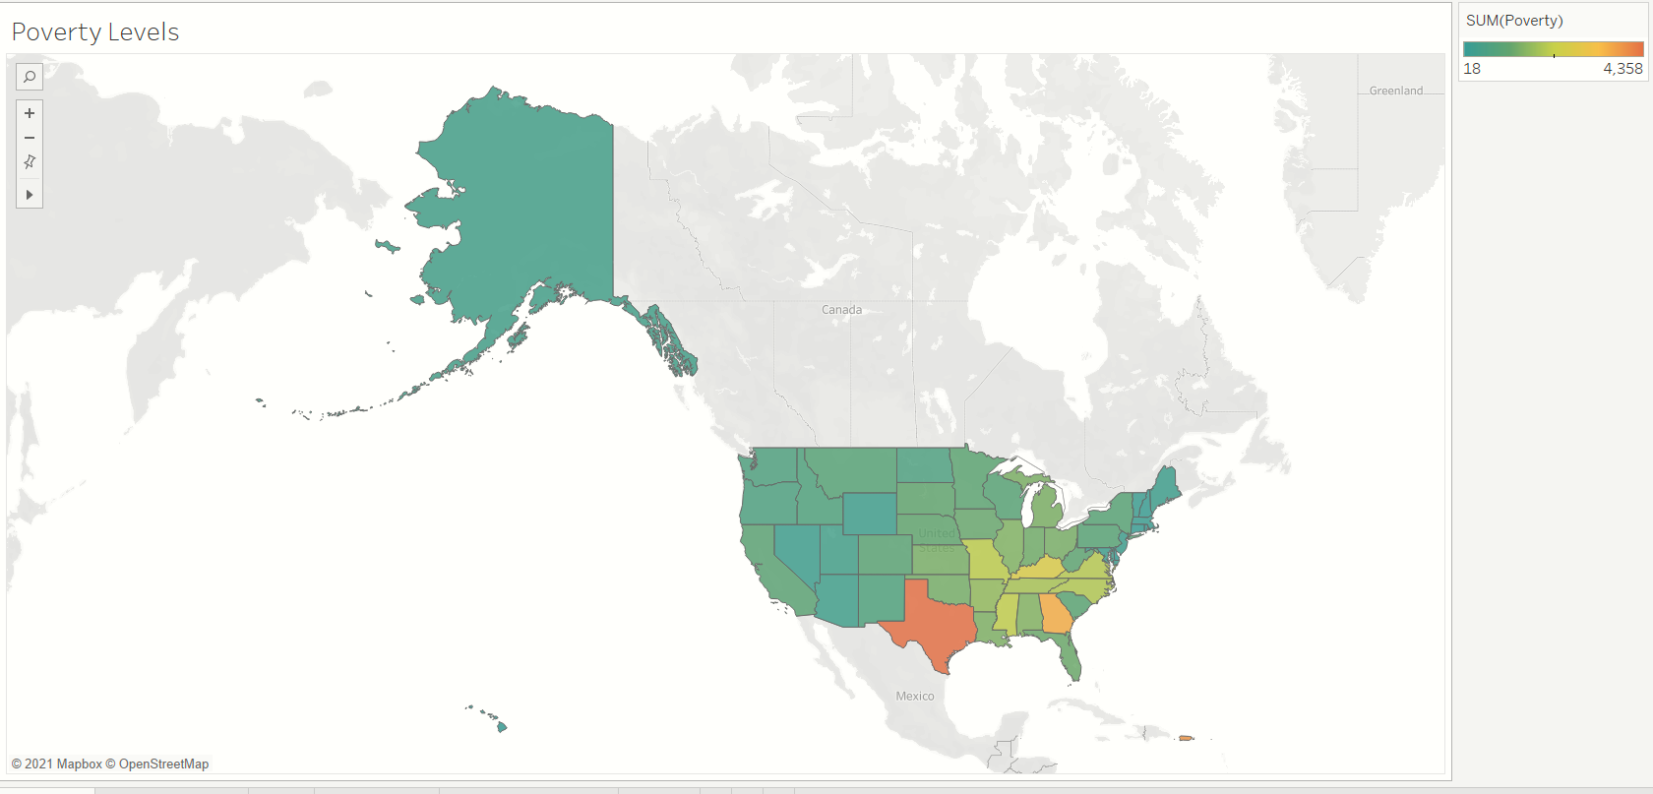
Which State has the highest percentage of the population below the poverty level?- Texas
I used a map because it is a good visual indicator of the different states.
I also used contrasting colors to show the highest vs lowest levels

Slide 9
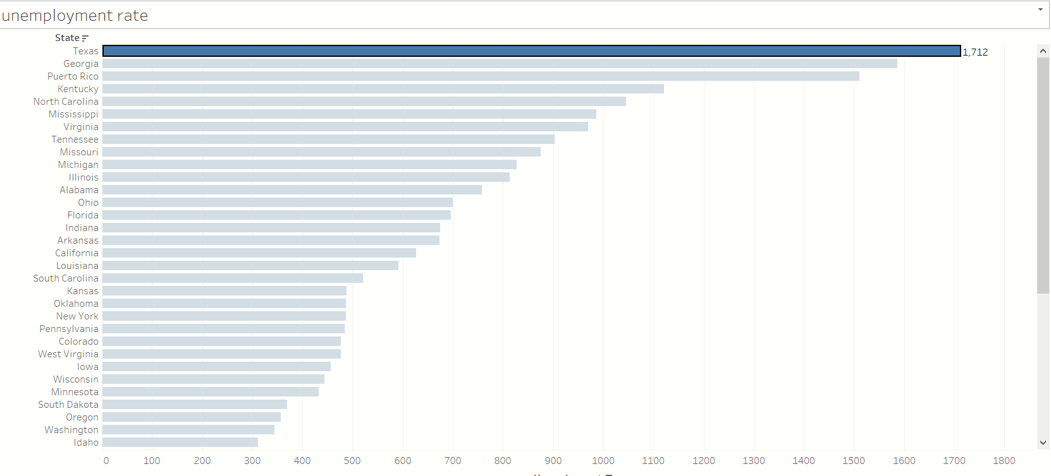
Which state has the highest unemployment levels?- Texas
I used a horizontal bar chart orderd by descending order.
An ordered bar chart enables one to rank categories, based on a quantitative variable

Slide 10
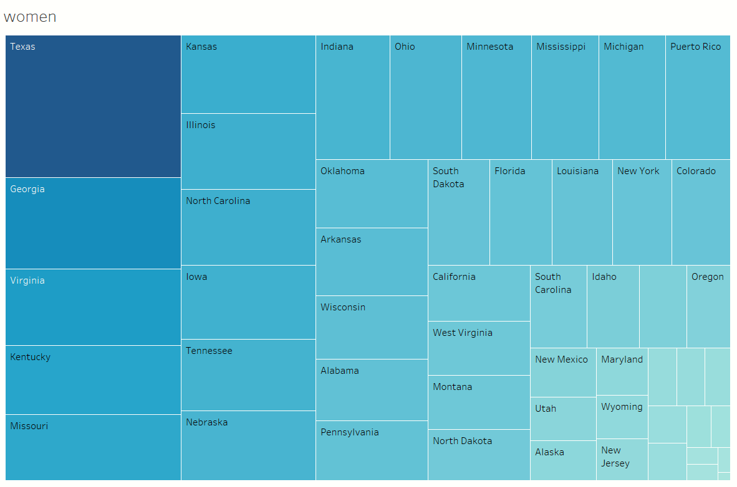
Which state has the highest percentage of women?- Texas ( Created a calculation [Women]/([Women]+[Men])
Tree map is a quick way to see the largest /smallest values, based on the categories

Slide 11
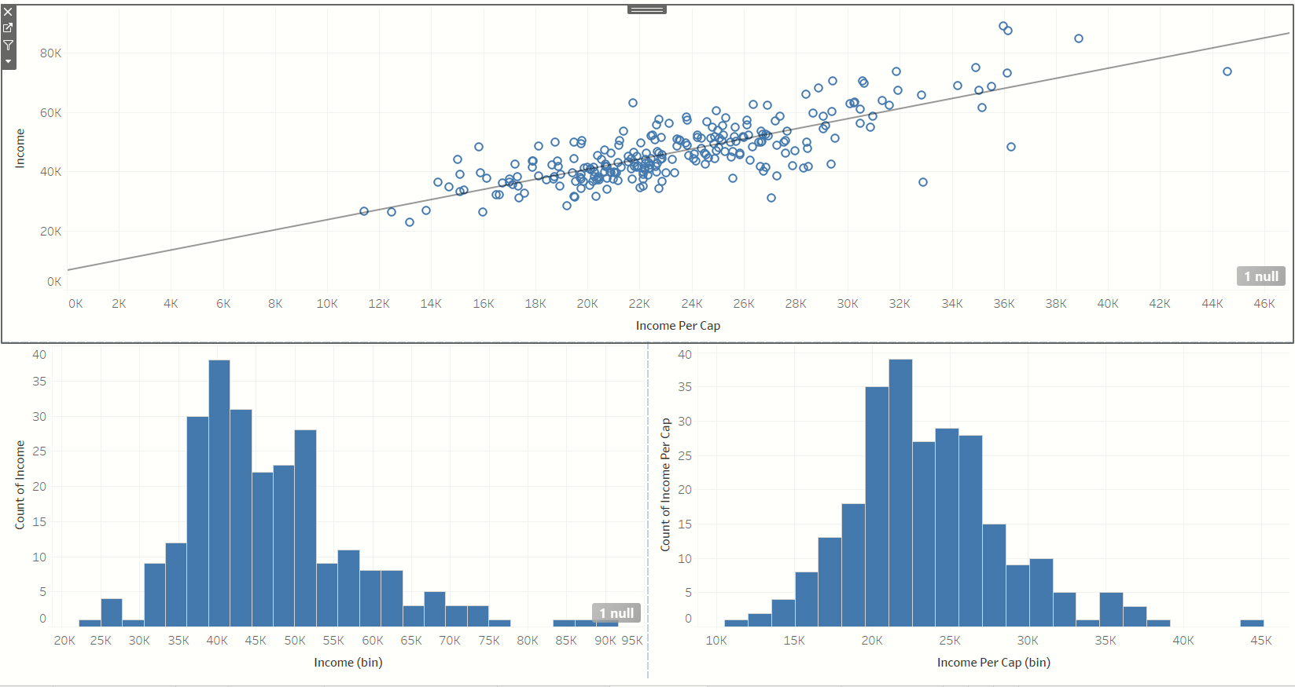
Income vs Income Per capita in Texas
A scatter plot shows correlation between income per cap and median house hold income. There is a strong positive correlation
Histograms show the distribution.
Histogram to the left shows that a majority of households earn an income of 39K.
Histogram to the right show that majority of counties have an income per capita of 21K.
This means our client should plan pay budgets within 21K and 39K

Slide 12
Recommendations
Our client should consider rolling our the program in Texas..
Our client should plan pay budgets within 21K and 39K

Slide 13
Resources
N/A

